Slide 1
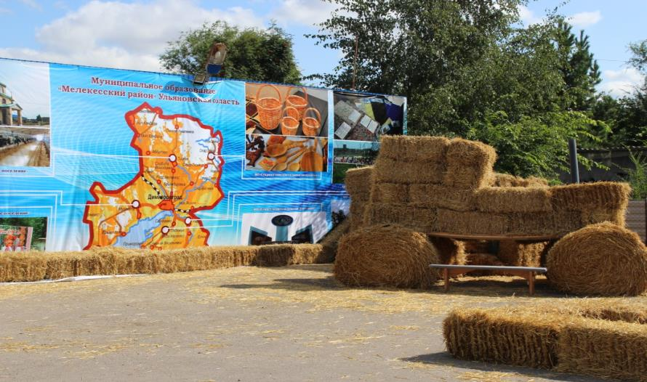
MO "Melekessky area" of the Ulyanovsk region
Population 34 500 pers.
Square area 3472 sq.km.
Formed in 1928,

Slide 2
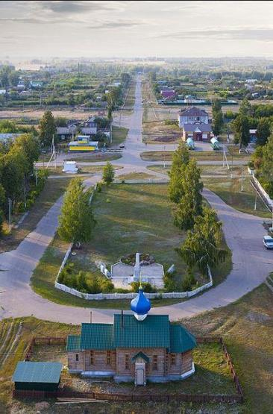
Historical reference
Melekessky District - administrative-territorial units and municipalities of the Ulyanovsk region of the Russian Federation. The largest area of ​​the area of ​​the square, founded in 1928, the district name comes from the river. Melekes.
History Melekessky district originated in the second half XVII century, during the construction of Zakamskreinforced strip. During this period, there are many settlements of these places.
Active development Melekessky region began in the mid XVIII century. Simbirskikhmerchants on the river Melekess almost one after the other, were built the distillery, which was carried out on a large scale bread wine and alcohol. The favorable position of the region ensures stable distribution as the primary products and waste products.

Slide 3
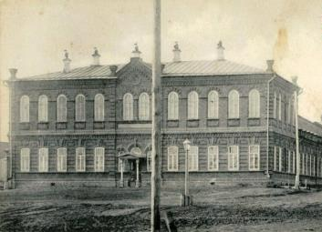
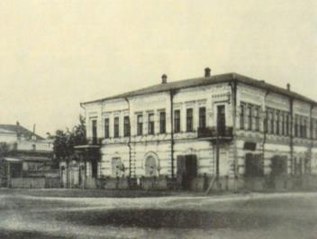
Active development Melekessky region began in the mid XVIII century. Simbirskikhmerchants on the river Melekess almost one after the other, were built the distillery, which was carried out on a large scale bread wine and alcohol. The favorable position of the region ensures stable distribution as the primary products and waste products.
At the end XIXcentury began to appear and flour mill sector companies and by 1913 operated for 9 mills. In addition,Melekesskyarea were brewery developed timber processing and woodworking. They build schools, hospitals, churches, mosques.

Slide 4
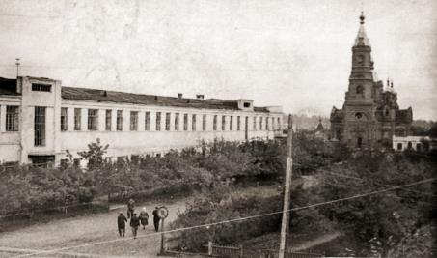
1917 revolution in MelekesskyDistrict did not go for very long, almost to the beginning of World War II. Not bypassed Melekessky area and famine in 1921, the Volga region, in the district quickly moved away from him and began to develop new forces. Opened factories, production, collective and state farms.
Do not stay in the area of ​​side during World War II, taking more than six thousand evacuees took Vitebsk hosiery knitting factory. All the production work on the needs of the front.
After the war, in the middle XXcentury economy continues its rapid growth rate of the pre-war. Built: teleretranslyator,Atomic Reactors, Combine technical felts, DAAZ. MZKA.
Of great importance in the history of Melekessky
Agricultural production area has
named after NK cooperative Krupskaya. In 1983, the economy for the first time reached the yield - 30 quintals per hectare.
There is an ongoing strengthening
material and technical base

Slide 5
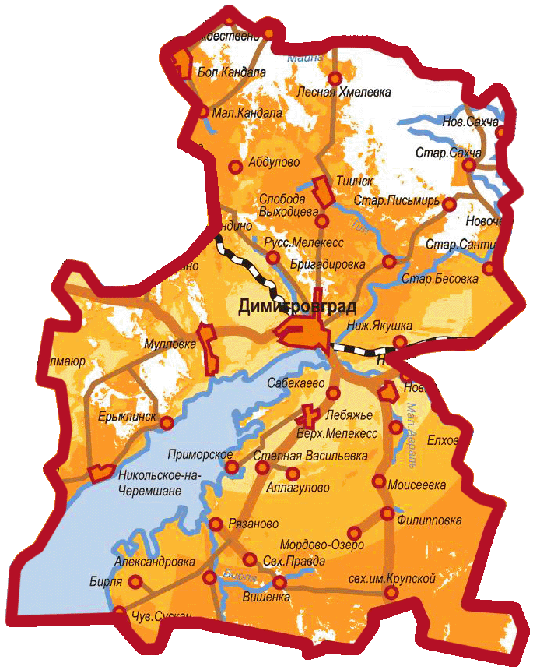
Administrative division
Melekessky district includes six rural settlements: Novoselkinskoe. Lebyazhye. Nikolocheremshanskoe. Riasanovsky. Starosahchinskoe. Tiinskoe and two urban settlements: Mullovskoe. Novomaynskoe.
The area is located on the left bank of the Ulyanovsk region. In the north-west it is bordered byStaromaynskim district, in the west - Cherdaklinsky district, in the east - Novomalyklinsky district of the Ulyanovsk region.
Neighborhood - is 347.2 thousand hectares of land, 464 km.. the total length of rural roads, 24 school routes, well-developed social infrastructure: schools, kindergartens, hospitals,FAPs, Clubs, libraries, art schools and art groups.

Slide 6
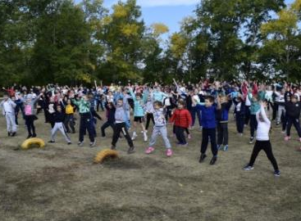
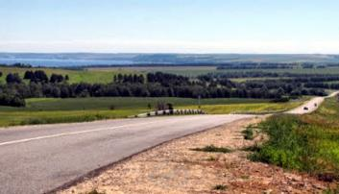
Climate
Population
The climate in Melekesskyis temperate continental. The average January temperature is about -13 degrees, in July - +19 degrees. However, there are exceptions, when the temperature in winter can drop to - 40 degrees, 39 degrees - in July. Most of the rainfall occurs between April and October. Around 30% of precipitation falls in November-March.
Population Melekessky District - 34684 people (2017). - 60% of Russian; 19% Tatar; 13% Chuvashes; 4% is Mordvinians; 4% other nationalities (Ukrainian, Chechens, Roma, Armenian and others).

Slide 7
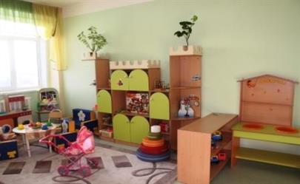
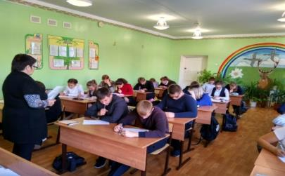
Education
On the territory of Melekessky district there are 22 municipal educational institutions, including schools and OGBPOU "Riasanovsky Agricultural College", 15 pre-school educational institutions.

Slide 8
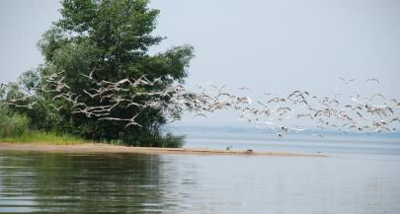
AT Melekessky area 7 nature monuments 91 waterbody 3 river reservoir 1, 20, lakes, ponds 47, 11 of springs.
nature monuments
Fake relic forests with. Nikolskoye-na-Cheremshan
Fake relic forests are recognized, they are to the east of s. Eryklinskand relate to Nikolsky forestry. One quarter of the forest area was approved as a natural monument.
The stand forms tillet height of 18-20 m, the average diameter of the barrel reaches limes 20-24 cm or more. Age linden - at least 80-100 years. Linden tree layer height 25-27 m, but not necessarily a small presence of the oak and maple, elm singly.
"Borok Island" (Krasnoyarsk)
The island is located on the CheremshanskyReach the Kuibyshev Reservoir 4 km south of the village of Nikolskoye-na-Cheremshan. The island area of ​​19 hectares.
There is heron breeding colony (the second largest in the Middle Volga).
On the island are marked: a pair of black kites and Hobby. In the middle of the island to the large pines found a nestwhite-tailed eagle. On the island are met: wood pigeon, coast swallow lesser whitethroat, finch. Around the island marked 6 black-headed gull, some silver, mew gulls frequent lake gull and common tern.Erne Black-headed Gull and included in the Red Book of Russia.

Slide 9
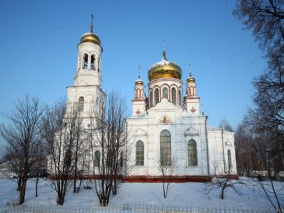
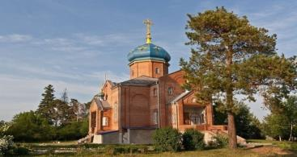
Monuments of cultural heritage AT Melekessky the area is 56 monuments of cultural heritage
The temple in honor of the birth of Christ, p. Lebyazhye
1901 s. Lebyazhye first brick church was built. He was consecrated in honor of the Nativity. First there was a ramshackle wooden church. In 1905, it installed an iconostasis. In 1930 the church was closed. In it at different times was a grain warehouse chemicals. According to popular legend, tractors of town right in the temple, damaging floor tiles. In 1989 the church was revived and Ilyin day of August 2, the first service was held.
Church of the Nativity, settlement Mullovka
Mullovka working village was founded in 1706. In 1759 the village was transferred into the possession of SG Melgunov. It was he who asked the industrial vector Rural Development, organized in 1785 a cloth factory.
In 1804, at his own expense the first church appeared in the village. It was a stone building with a bell tower. The temple had three altars. Temple destroyed in Soviet times. Only in the 90sXX century there was an opportunity to build a new church. January 10, 1999 on its feast day church was consecrated.

Slide 10
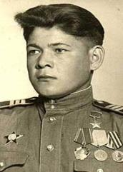
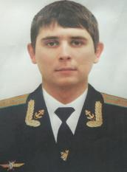
House of the Soviet Union Hero
IN AND. Ermeneeva
The house is located in a hero. Abraham. IN AND.Ermeneev He was born in 1925 in a. Abraham. In January 1942 he was drafted into the Red Army. In September 1943, he was sent to the Leningrad front. During the offensive in January 1944, the regiment was covering the 46thLugaInfantry Division in the direction of Pskov, was then thrown at Vyborg. June 20, 1944 on the military convoy was accompanied by 4th Battery Lieutenant GVSchutz. Cork from the accumulation of tanks, trucks with ammunition soon discovered a German reconnaissance plane. Cannon Junior Sergeant V.ErmeneevaIt took care of all the German planes bomb load. During this battle antiaircraft awarded the Order of the Red Star and promoted to the rank of the Hero of the Soviet Union. Hero antiaircraft fought came to Berlin. After the war, he returned home.
Alley of Memory YY Medvedkov
On the territory of high school Russian village Melekess laid Rowan Alley of Memory Yuri Y. MedvedkovWho died performing their military duty in Syria. At the solemn meeting organized by the students of the school where he once studied Jura Medvedkov, Sounded patriotic songs and poems. The memory of the deceased pilot observed a minute of silence. "Bookmark alley Memory - is evidence of the recognition of the people of the greatness of the feat of the soldiers who took over the cruel blow of terrorist attacks, died heroically in the performance of military duty.

Slide 11
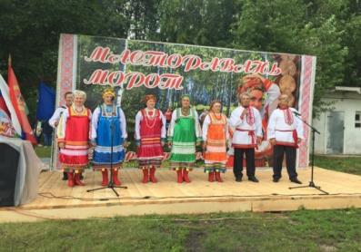
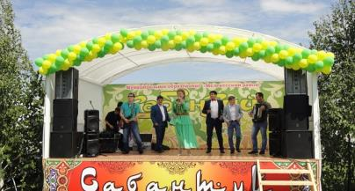
National holidays, traditions and customs
Mordovia holiday Mastoravan Moroto ( "Mother Earth Song")
Festival is held annually in the village Aleksandrovka, which became the center of the Mordovian culture.
Sabantuy ( "Feast of the plow")
Traditional regional festival of Tatar national culture "Sabantuy" is held annually on the first Saturday after the completion of planting. At the celebration honoring the foremost agricultural production at the end of spring field work, excellent students are awarded a letter of thanks. For the participants of the event organized sports, gaming, shopping areas and a big concert.

Slide 12
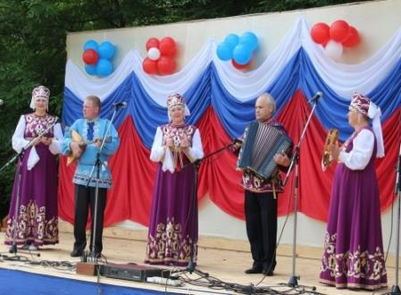
National holidays, traditions and customs
Celebration "Russian birch"
Annually, n. Novoselki passes festival "Russian birch". Traditionally on this daySPKKrupskaya honored those who work in the fields and farms - people in love with their work, in their professions and in their work. This is a great event attracts people not only from five offices grain farm, but also the neighboring villages, as well as neighboring regions.

Slide 13
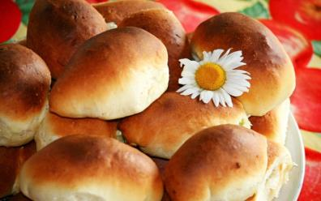
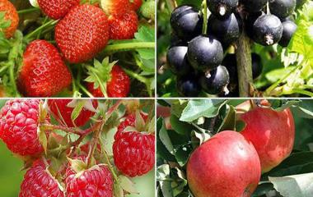
Capital Melekessky District
R. Mullovka n -. 'Pie Shop Capital "
Melekessky area boasts wonderful mullovskimipies, cakes, bread and bakery products. All this is the merit of two renowned bakers - Director of "Volga" Alexander V. Pronin and Director of LLC "Niva" Tatyana NikolayevnaValeeva - and their teams.
from. Nikolskoye-na-Cheremshan - "fruit-berry" capital
The Nicholas-on-Cheremshan growing more than five thousand apple trees, thousands of trees, plums, cherries, currant bushes, gooseberries, sea buckthorn. FItel village collect multi-ton harvest of vegetables, berries and fruit. This explains the assignment of this status.

Slide 14
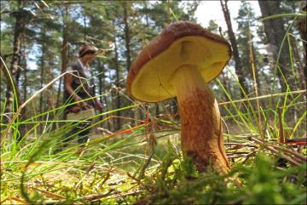
Capital Melekessky District
from. oldSahcha - the Capital of Handicrafts
. N Forest - "mushroom" capital
The village festivals are held annually in which numerous exhibition compositions that reflect the richness of the harvest.
old Sahcha- an ancient village, which is over 350 years old, it is located in a forested area near the river Small Cheremshan. This led to the development here of old crafts such as the production of wooden log cabins, wells, carts, sleds, boats, tubs salting. famousSahcha his boots, embroidered national Chuvash towels, knitting warm woolen mittens and socks, a wicker basket, bast, manufacture gear for fishing and beekeeping.

Slide 15
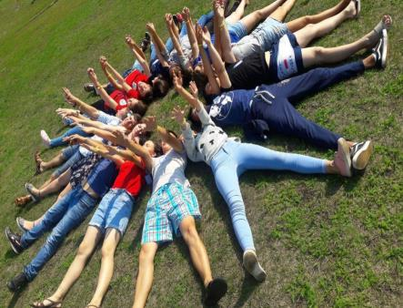
Capital Melekessky District
from. Ryazanovo - Youth Capital
As part of the festival. Ryazanovo It was Prisovo the status of the youth area of ​​the capital.
from. Tiinsk - Spring Capital
In 2014, the festival will continue a series of traditional "capital" of activities that take place every year in one of the settlements of the area.
One of the main events of the festival was the opening of the Center of Russian culture on the basis of a rural secondary school.
The school already has a museum of Russian culture and way of life, it is now allocated space for the Russian Culture Center Meeting creative groups, among its objectives the organization of regional cultural events.

Slide 16
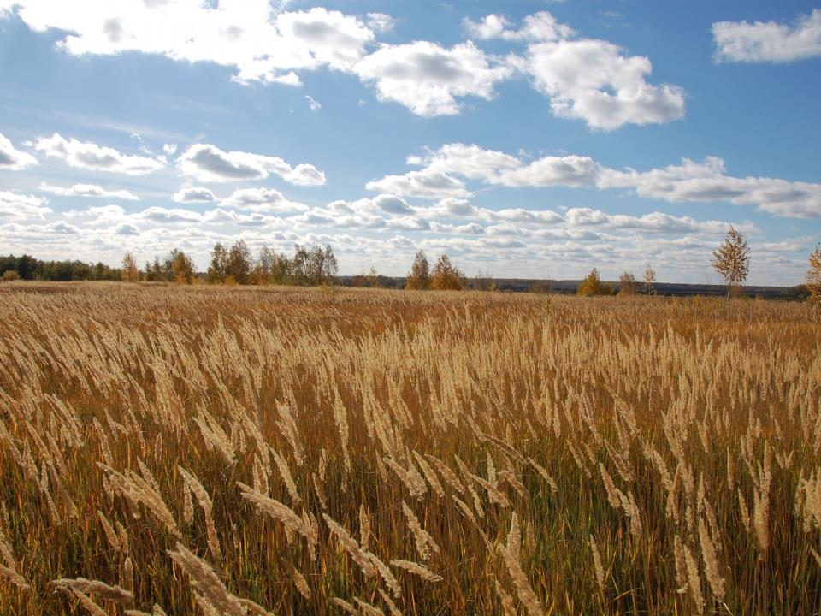
Contact details «Melekessky area»
Address: st. Khmelnitsky,d.93
Dimitrovgrad, 433508
Phone: (84235) 2-62-90
e-mail: tallex@list.ru
Official site: http: //adm-melekess.ru

